Slide 1
Traffic Management System

Slide 2
Project definition
An Internet of Things (IoT)-enabled intelligent traffic management system can solve pertinent issues by leveraging technologies like wireless connectivity & intelligent sensors. Considered a cornerstone of a smart city, they help improve the comfort and safety of drivers, passengers & pedestrians.

Slide 3
Design Thinking
Introduction
Literature Survey
Working
Results
Conclusion & Future Work

Slide 4
Introduction
One of the major problems faced in any metro city is traffic congestion. Heavy traffic is a headache for each and every person driving the vehicle and even to the traffic police in controlling the traffic.
Traffic congestion has a negative impact on economy, the environment and the overall quality of life.
There are two ways through which traffic is been controlled
a) Manually
b) Systematically (Controllers)

Slide 5
One of the oldest ways of handling traffic was having a traffic policeman deployed at each junction.
Traditional Traffic light controllers: It uses a fixed predetermined schedule for traffic inflow for each direction.
However the whole idea of a fixed time traffic light controller is not convenient for cities where traffic flow is variable.
For this reason a dynamic traffic control system is needed, which controls the traffic signals according to the density of traffic.

Slide 6
In our project we focus on optimization of traffic light using IR sensors and Arduino UNO as a microcontroller.
In our project our approach is to take data/input from IR sensors it will allow us to detect whether the road is congested or not and will allow us to manage our traffic according to our input.

Slide 7
Literature Survey
[1]This paper suggests implementing a smart traffic controller using real-time image processing. It used filtering method, which filtered the image and released all waste objects and only showed the cars. It has been customized to be used to control the traffic light sign by giving each sign sufficient time, depending on the number of cars on each direction.
[2] this paper the author optimize the traffic using microcontroller this system reduce traffic jams problem cause by traffic light to extent. The system contains IR Transmitter and IR Receiver. IR count the vehicles on the road Microcontroller generates the result.

Slide 8
[3]In this paper the traffic control system based on (WSN) wireless sensor Network. In that System Time manipulation Used for controlling Traffic Light. This System Control Traffic over Multiple intersections. The vehicles transmits the RF signal and code. The sensor on traffic signal detects the signal and receives the code and communicates wirelessly with traffic lights controller.
[4] System is based on a simple principle of RFID tracking of vehicles, can operate in real-time, improve traffic flow and safety, and fully automated, saving costly constant human involvement.

Slide 9
References
[1] Cucchiara, Rita, Massimo Piccardi, and Paola Mello. "Image analysis and rule-based reasoning for a traffic monitoring system." In Proceedings 199 IEEE/IEEJ/JSAI International Conference on Intelligent Transportation Systems (Cat. No. 99TH8383), pp. 758-763. IEEE, 1999.
[2] Sinhmar, Promila. "Intelligent traffic light and density control using IR sensors and microcontroller." International journal of advanced technology & engineering research (IJATER) 2, no. 2 (2012): 30-35.

Slide 10
[3]Nellore, Kapileswar, and Gerhard Hancke. "A survey on urban traffic management system using wireless sensor networks." Sensors 16, no. 2 (2016): 157.
[4]Chattaraj, Anuran, Saumya Bansal, and Anirudhha Chandra. "An intelligent traffic control system using RFID." IEEE potentials 28, no. 3 (2009): 40-43.

Slide 11
Working
This project works on the principle that when a car passes between the IR transmitter and IR receiver, the IR light is blocked and as the result the resistance of the photodiode increases. This change in resistance is converted to electrical pulses, which is used to control traffic lights.

Slide 12
Components Used
Arduino UNO
IR Sensors (IR Transmitter & IR Receiver)
LED’S (12)
Resistors(1k ohm)
Power Supply (5V)
Jumping Wires

Slide 13
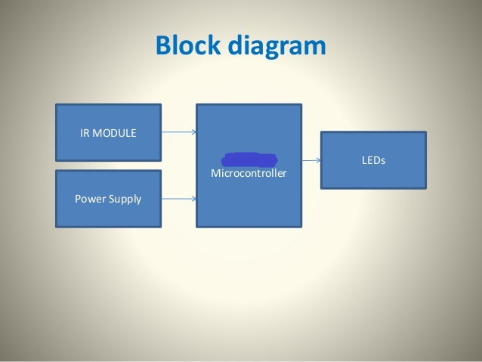
Block Diagram

Slide 14
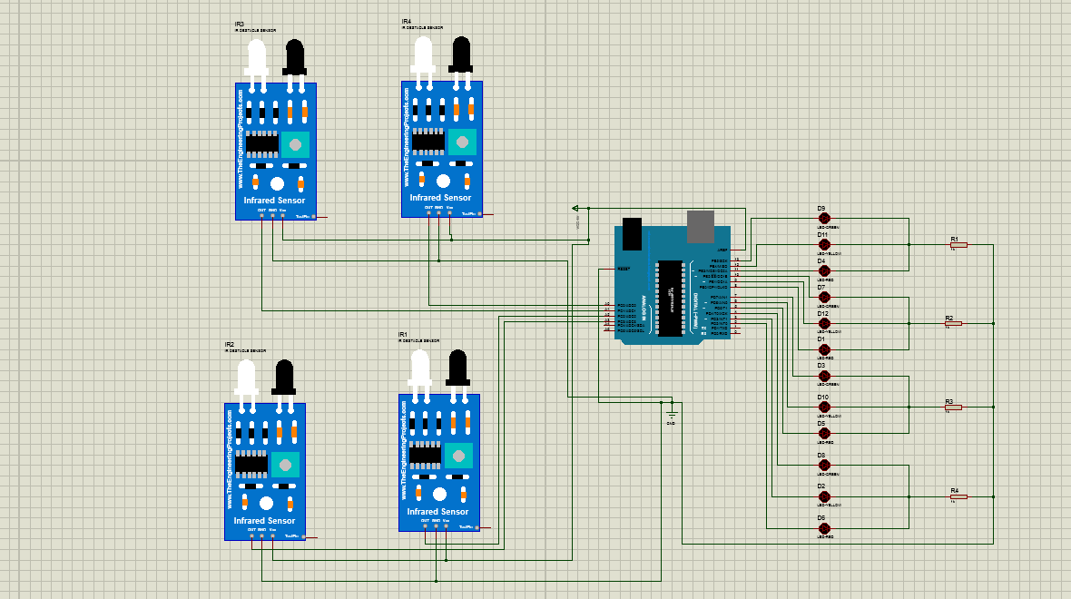
Circuit Diagram
IR Sensors
Arduino UNO R3
Resistors with LEDS

Slide 15
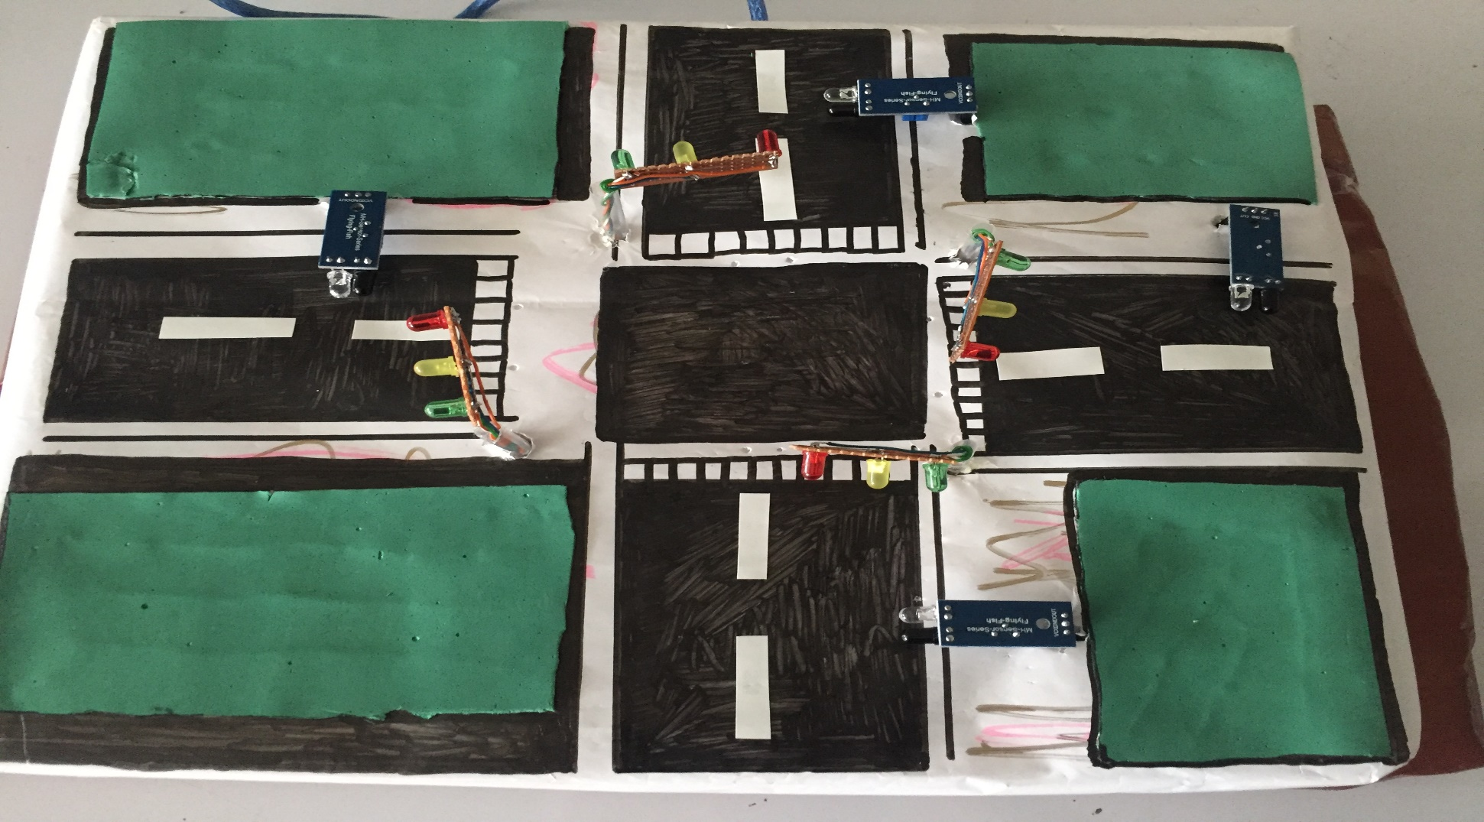
Results

Slide 16
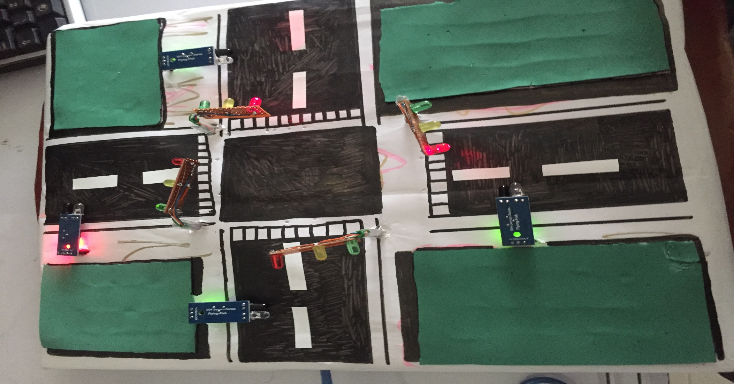

Slide 17
Conclusion & Future Work
In this project we have studied the optimization of traffic light controller in a City using IR sensors and microcontroller. By using this system we tried to reduce the possibilities of traffic jams, caused by traffic lights and we have successfully gets the results. Number of passing vehicle in the fixed time slot on the road decide the density range of traffics and on the basis of vehicle count microcontroller decide the traffic light delays for next recording interval

Slide 18
The proposed work in this project is to eliminate the traffic congestion problem but still a lot of work can be done on this project or on the other traffic problems.
Improvements in this Project
1) We can use RFID Tags instead of IR sensors as there range is limited so we can use RFID system.
2) We can use different Micro Controllers (Raspberry Pi,PIC Microcontroller).

Slide 19
3) we can make a system for pedestrian path along with this project as well.
4) We can make a signal free system for an ambulance.
5) We can attach LCDs with signals with the following information (when our signal is going to open and for how much time is going to be open).

Slide 20


